Slide 1

Get better performance of your MPF
Group 3:
Ko Wai Mei

Slide 2

Objective of the analysis
Find the weightings of fund that can beat the market (HSI) with reasonable risk

Slide 3
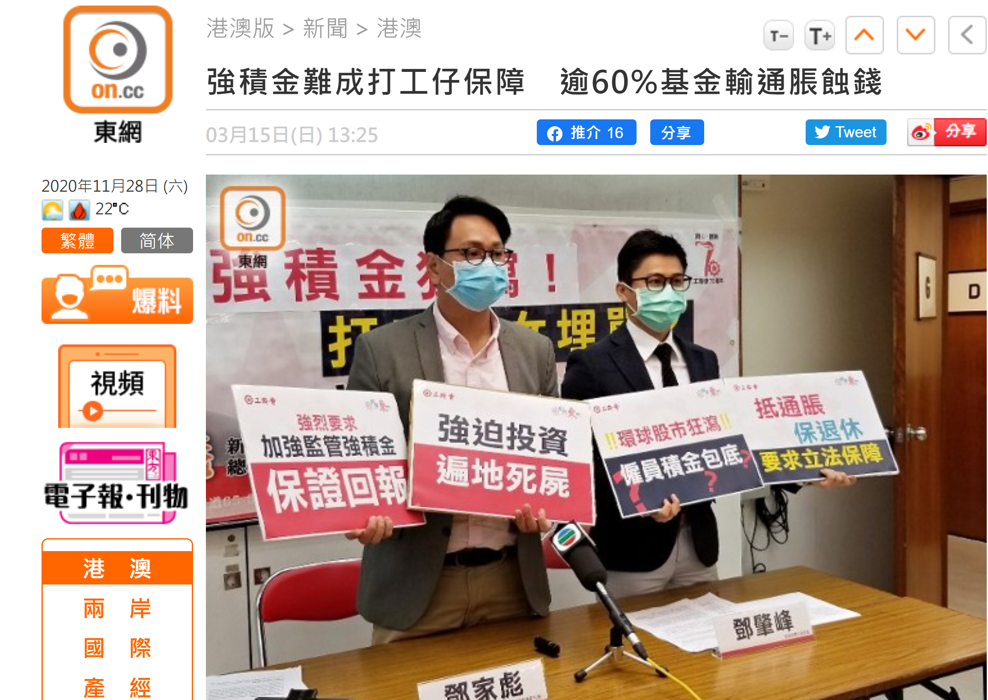




Slide 4
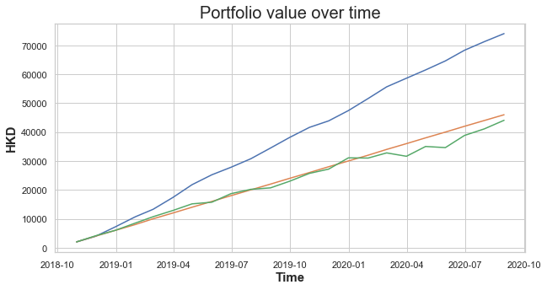
Portfolio value evolution
Backtesting result during
31/10/2018 - 30/9/2020
Our System
Investing in HSI
Without Investing
Portfolio of our fund selecting system
VS
Portfolio invested in HSI

Slide 5
Portfolio statistic
Backtesting result during
31/10/2018 - 30/9/2020
System Selected Portfolio
HSI
Total period retuen (%) | 9.692 | -15.580
Total period standard deviation (%) | 4.436 | 0.058
Annulised return (%) | 4.736 | -8.12
Annulised standard deviation (%) | 1.132 | 0.788

Slide 6
Background info of the model
Available fund provided by AIA
Total 24 funds
65歲後基金
大中華股票基金
中港動態資產配置基金
中港基金
日本股票基金
北美股票基金
全球基金
均衡組合
亞洲股票基金
亞洲債券基金
亞歐基金
美洲基金
香港股票基金
核心累積基金
基金經理精選退休基金
強積金保守基金
富達增長基金
富達穩定資本基金
富達穩定增長基金
綠色退休基金
增長組合
歐洲股票基金
環球債券基金
穩定資本組合

Slide 7

Risk profile of user
Background
Will contribute fixed amount per month to his/her MPF account
In the backtesting example, assuming HKD2000/month
Willing to rebalance his/her portfolio each month
Aggressively get capital growth with a relatively safe asset allocation

Slide 8
Risk profile of user
Proposed requirement:
Investment Taget | Get large capital growth
Risk Aversion | Low - Medium
Target Return | > HSI annulised return than 4%
Volitility | < HSI annulised volitility

Slide 9
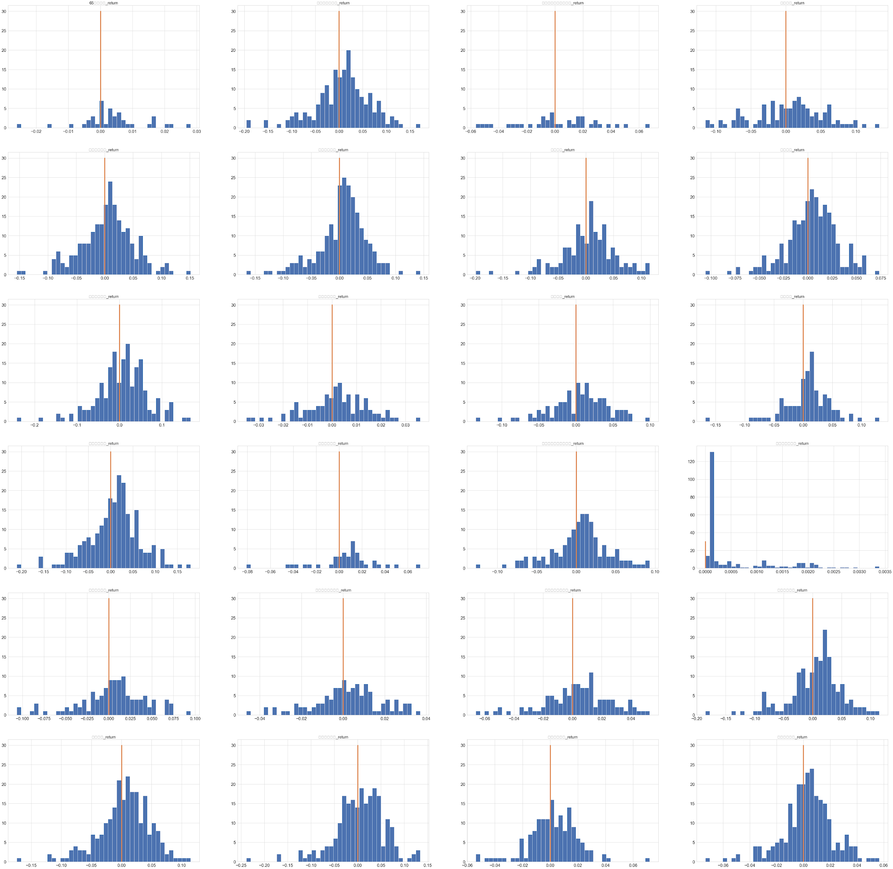
Fund selection System
Websites of the MPF schemes/
Other sourses
Data
Get the monthly return from data
From 2000-12-01
to 2020-10-22
Distribution of funds monthly return
Some funds have more positive return obviously

Slide 10
Fund selection System
Data
Label the weightings with 0:
Monthly return lower than 6 month HSI average return
Higher period volatility than HSI
Label the weightings with 1:
Monthly return higher than 6 month HSI average return
Lower period volatility than HSI
Modeling data
Test data
Use slicing window and generate weight for each fund in each period
Analyse the monthly return
by applying the weightings for a month
From 2000-12-01
to 2018-09-30
From 2018-10-31
to 2020-9-30

Slide 11
LightGBM Model
With GridSearch
With Cross validation
Weightings with label
Fund selection System
Enter the test stage with trained model
Input the weightings generated for specific period
Filtered weightings with predicted label of 1
Select the weighting produces highest average selected period return
Learn what factors make the weightings good ->
those with Label 1

Slide 12
Simple system process
Input:
Weightings for period
Model:
Filter good weightings
Good weighting
Apply weighting for fund selection
Select weighting with highest return

Slide 13
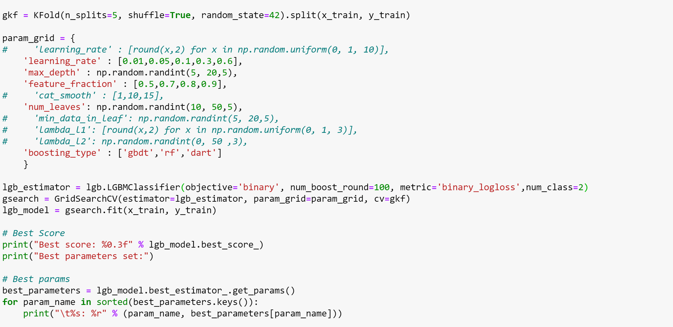
Model display
Data collection & construction:
web scrape & other data source
Label: outperform HSI >4% within the selected period
Model selection & training & evaluation & optimization
Model:
Lightgbm classifier (Boosting)
Metrics: (Average)
Accuracy ~60%
HP tunning: GridSearch & 5 fold Crocss Validation

Slide 14
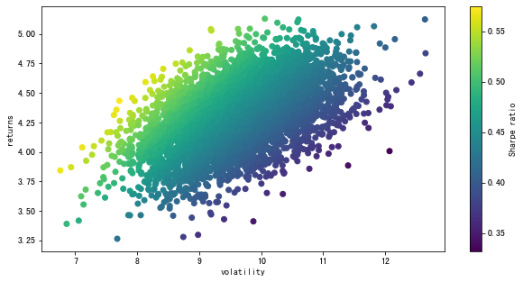
Weighting Generation
Random generate weighting to sample different market portfolios

Slide 15
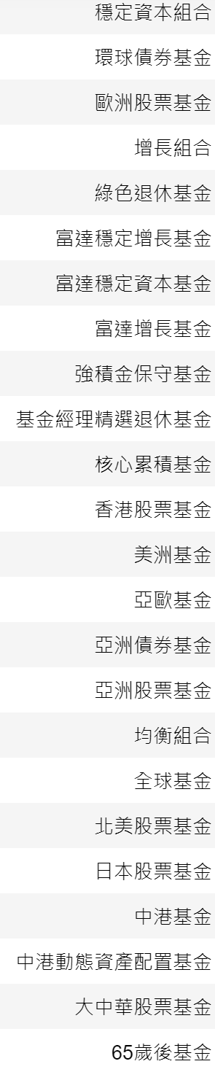
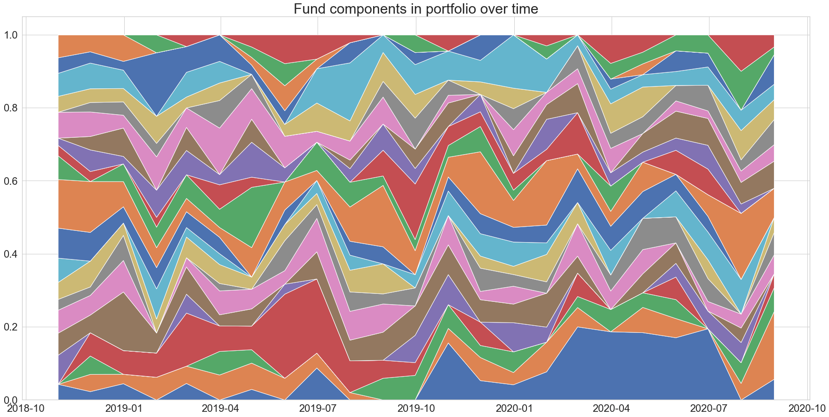
Components of fund over time

Slide 16
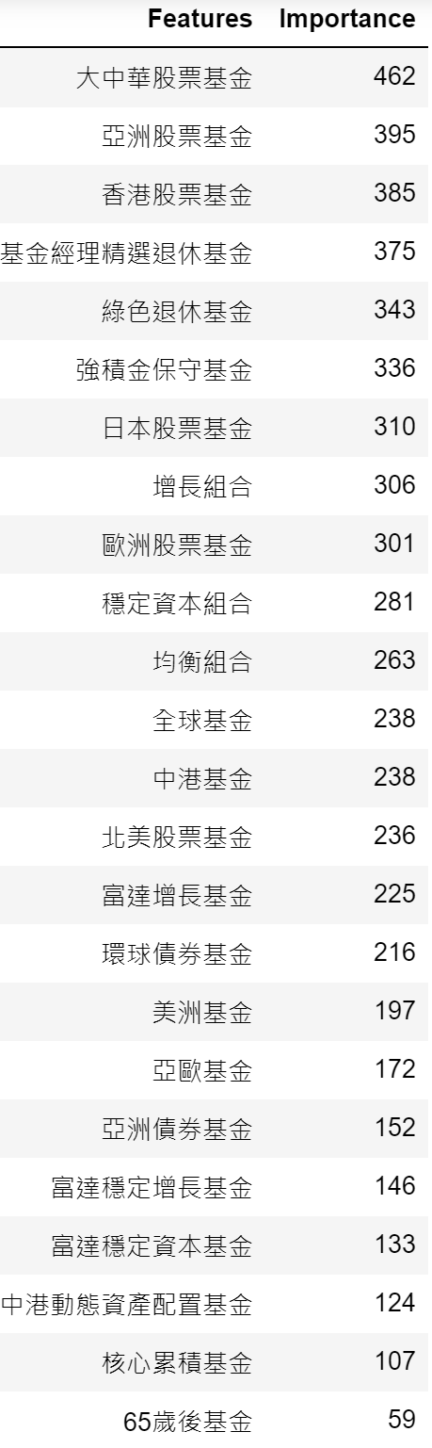
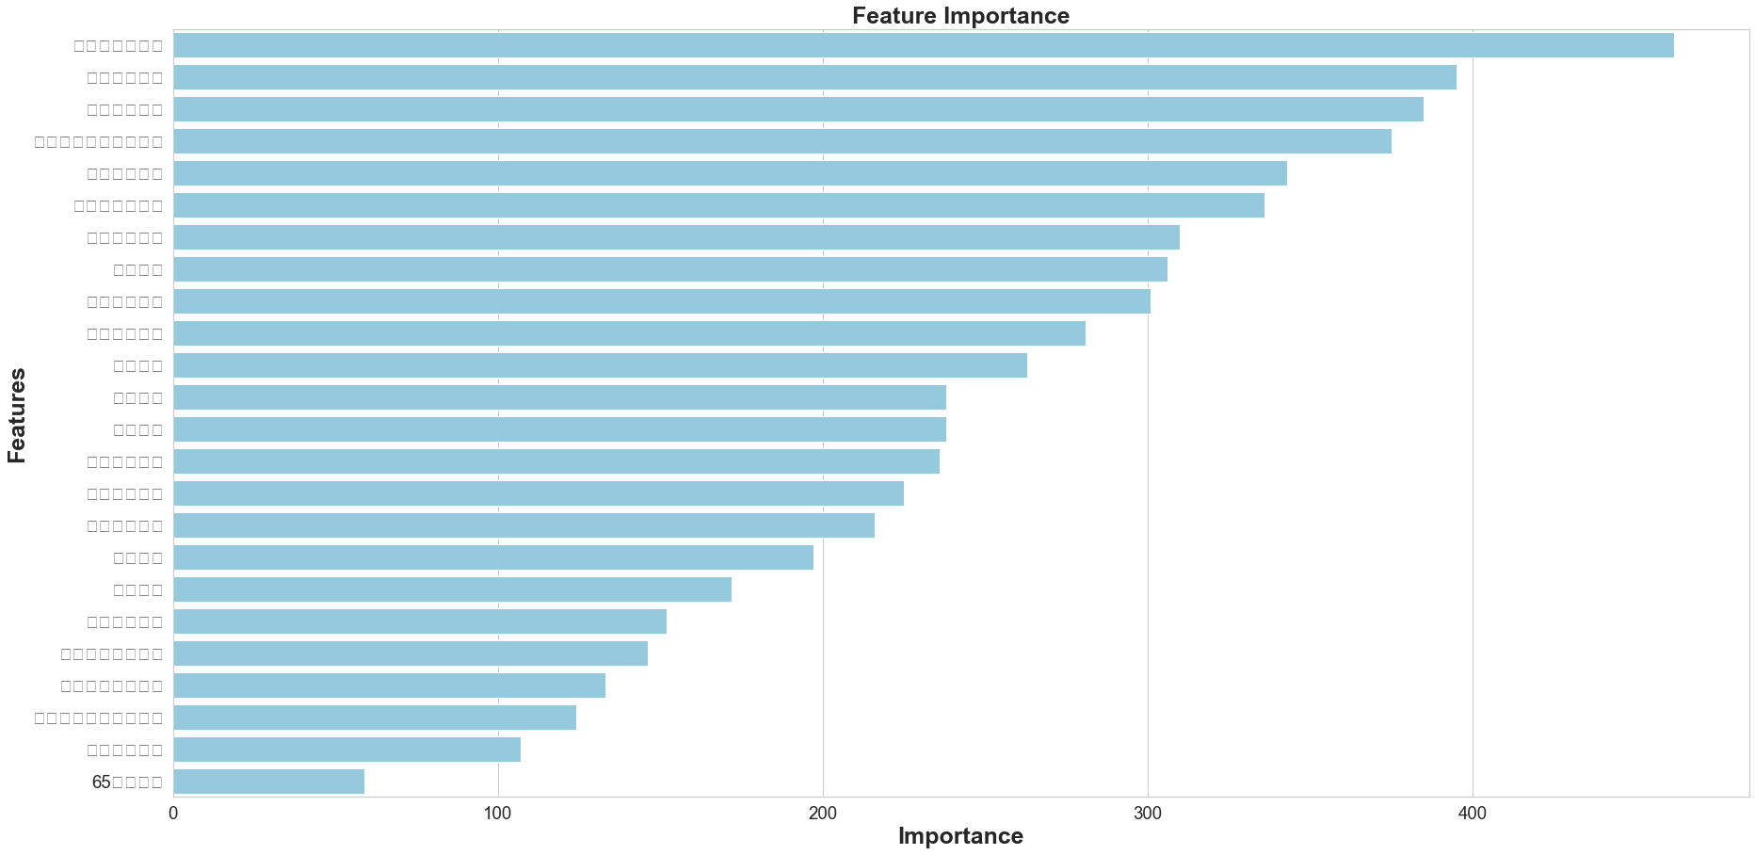
Features Importance

Slide 17

Appendix:
Details of fund with high importance in model

Slide 18
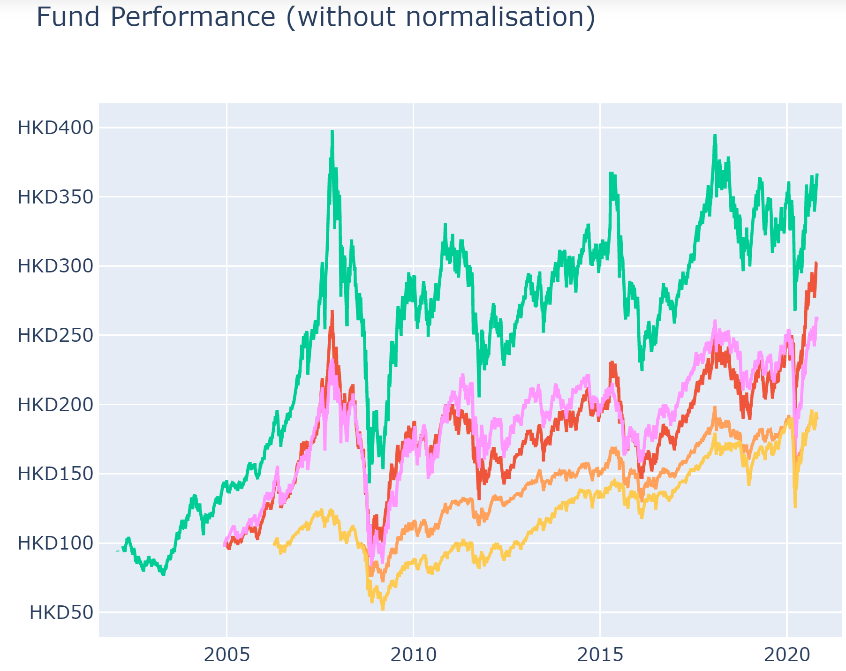
Features Exploration
Combined funds graph

Slide 19
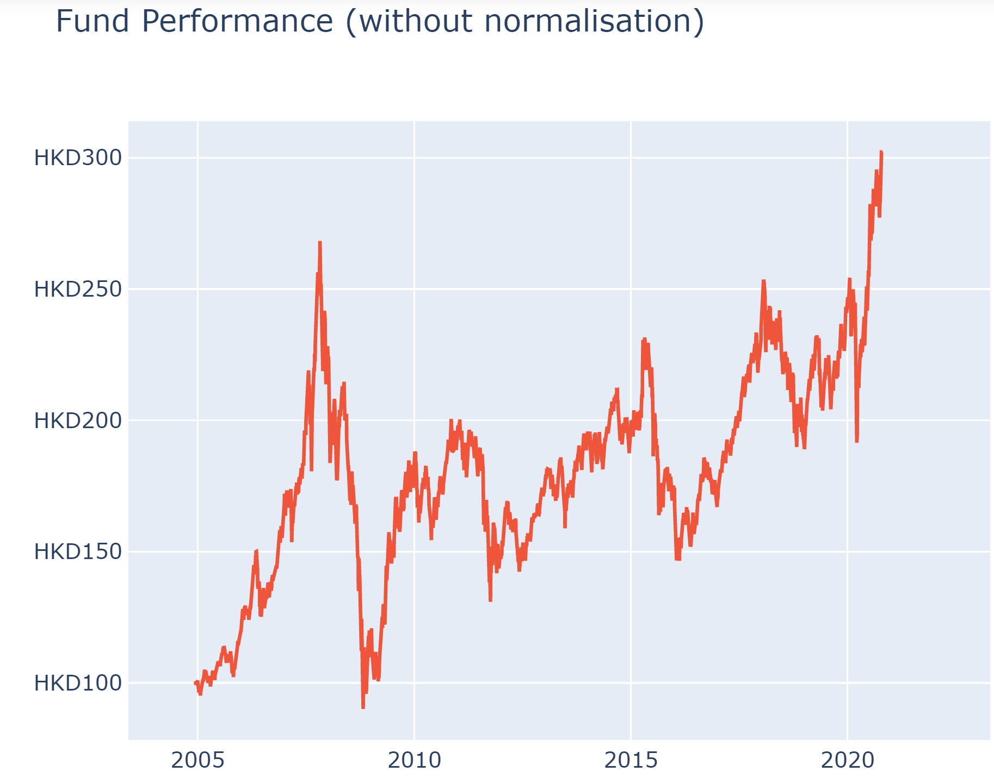
Features Exploration
大中華股票基金

Slide 20
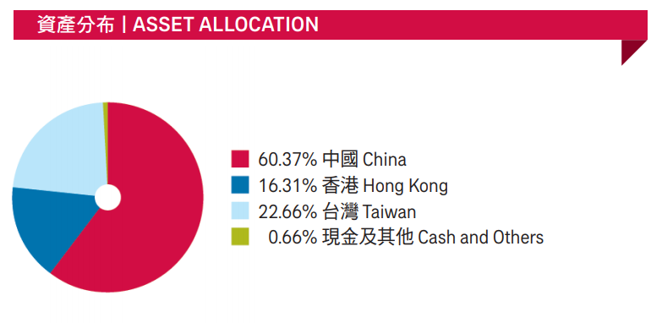
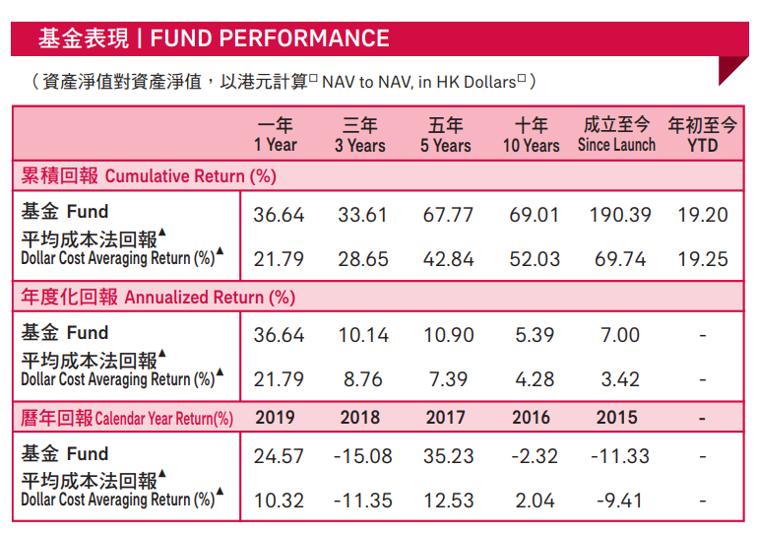
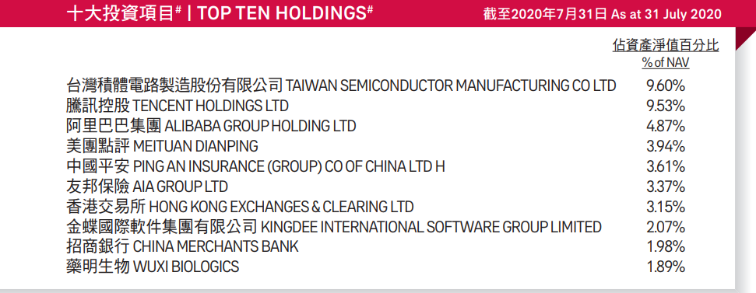
Features Exploration
大中華股票基金
source:
aia mpf prime value choice fund performance review-aug-2020

Slide 21
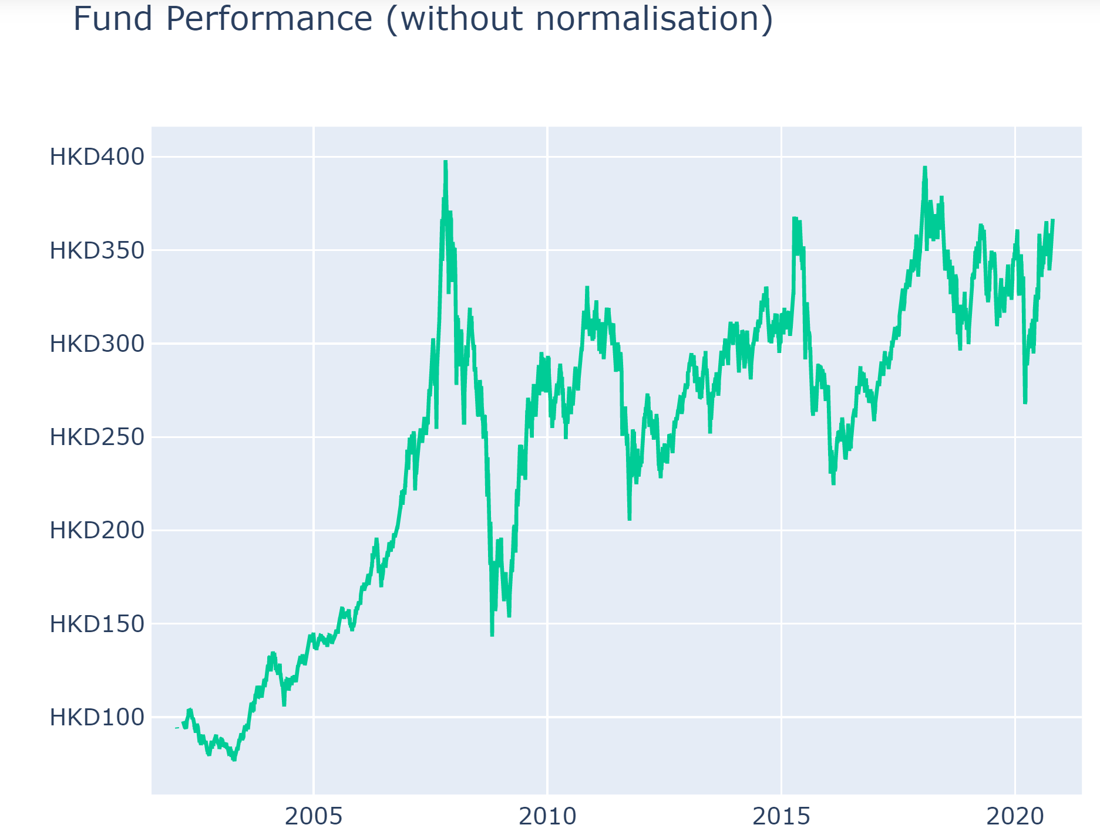
Features Exploration
香港股票基金

Slide 22
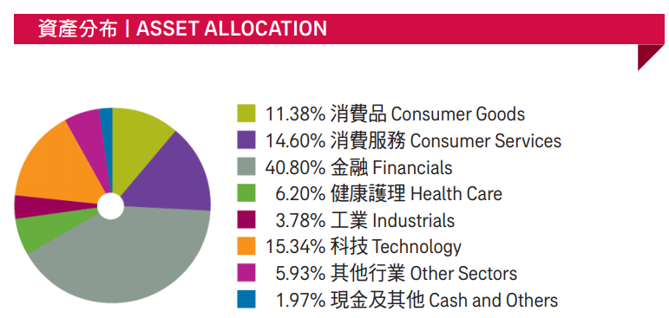
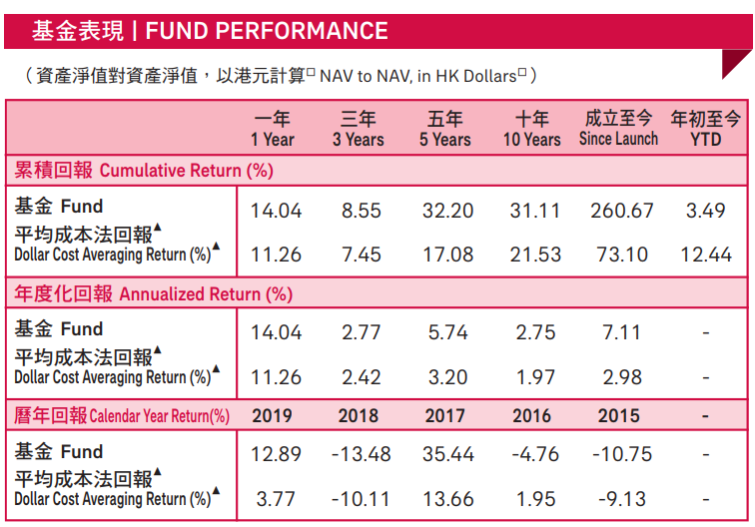
Features Exploration
香港股票基金
source:
aia mpf prime value choice fund performance review-aug-2020

Slide 23
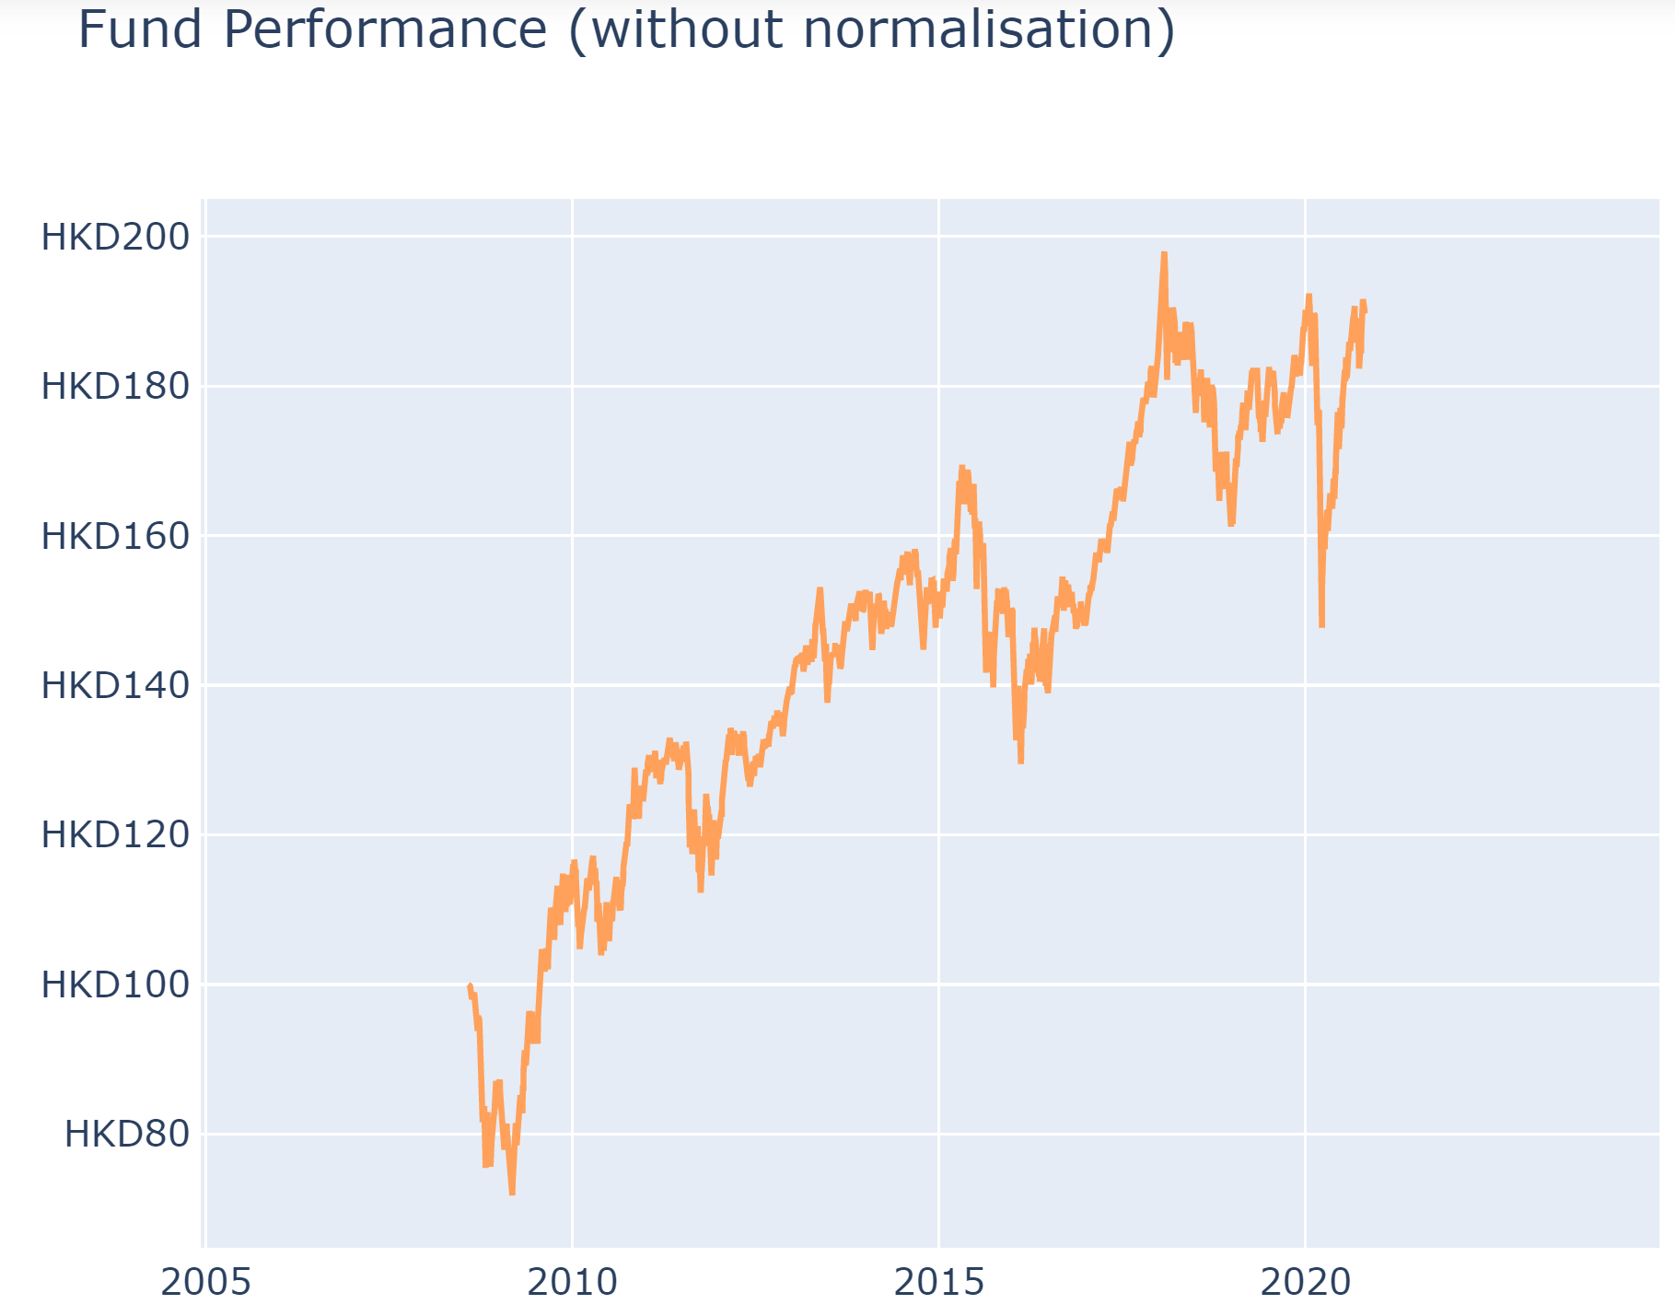
Features Exploration
基金經理精選退休基金

Slide 24
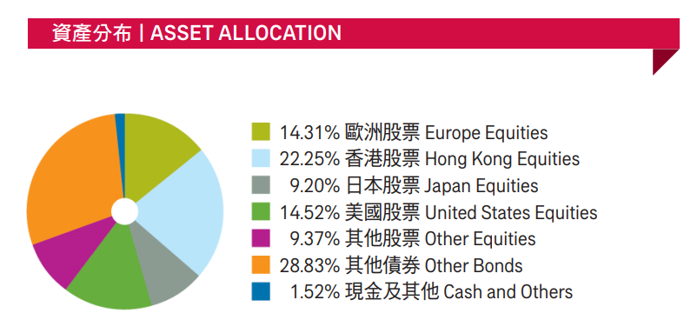
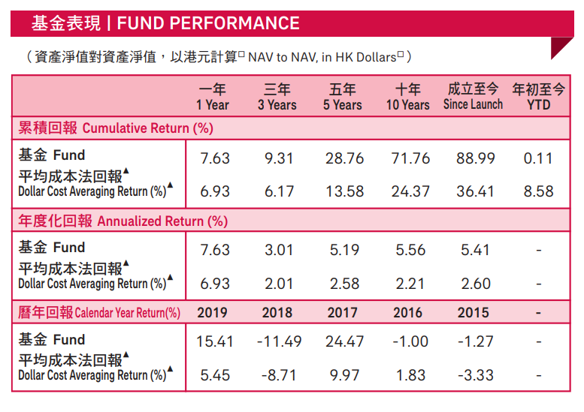
Features Exploration
基金經理精選退休基金
source:
aia mpf prime value choice fund performance review-aug-2020

Slide 25
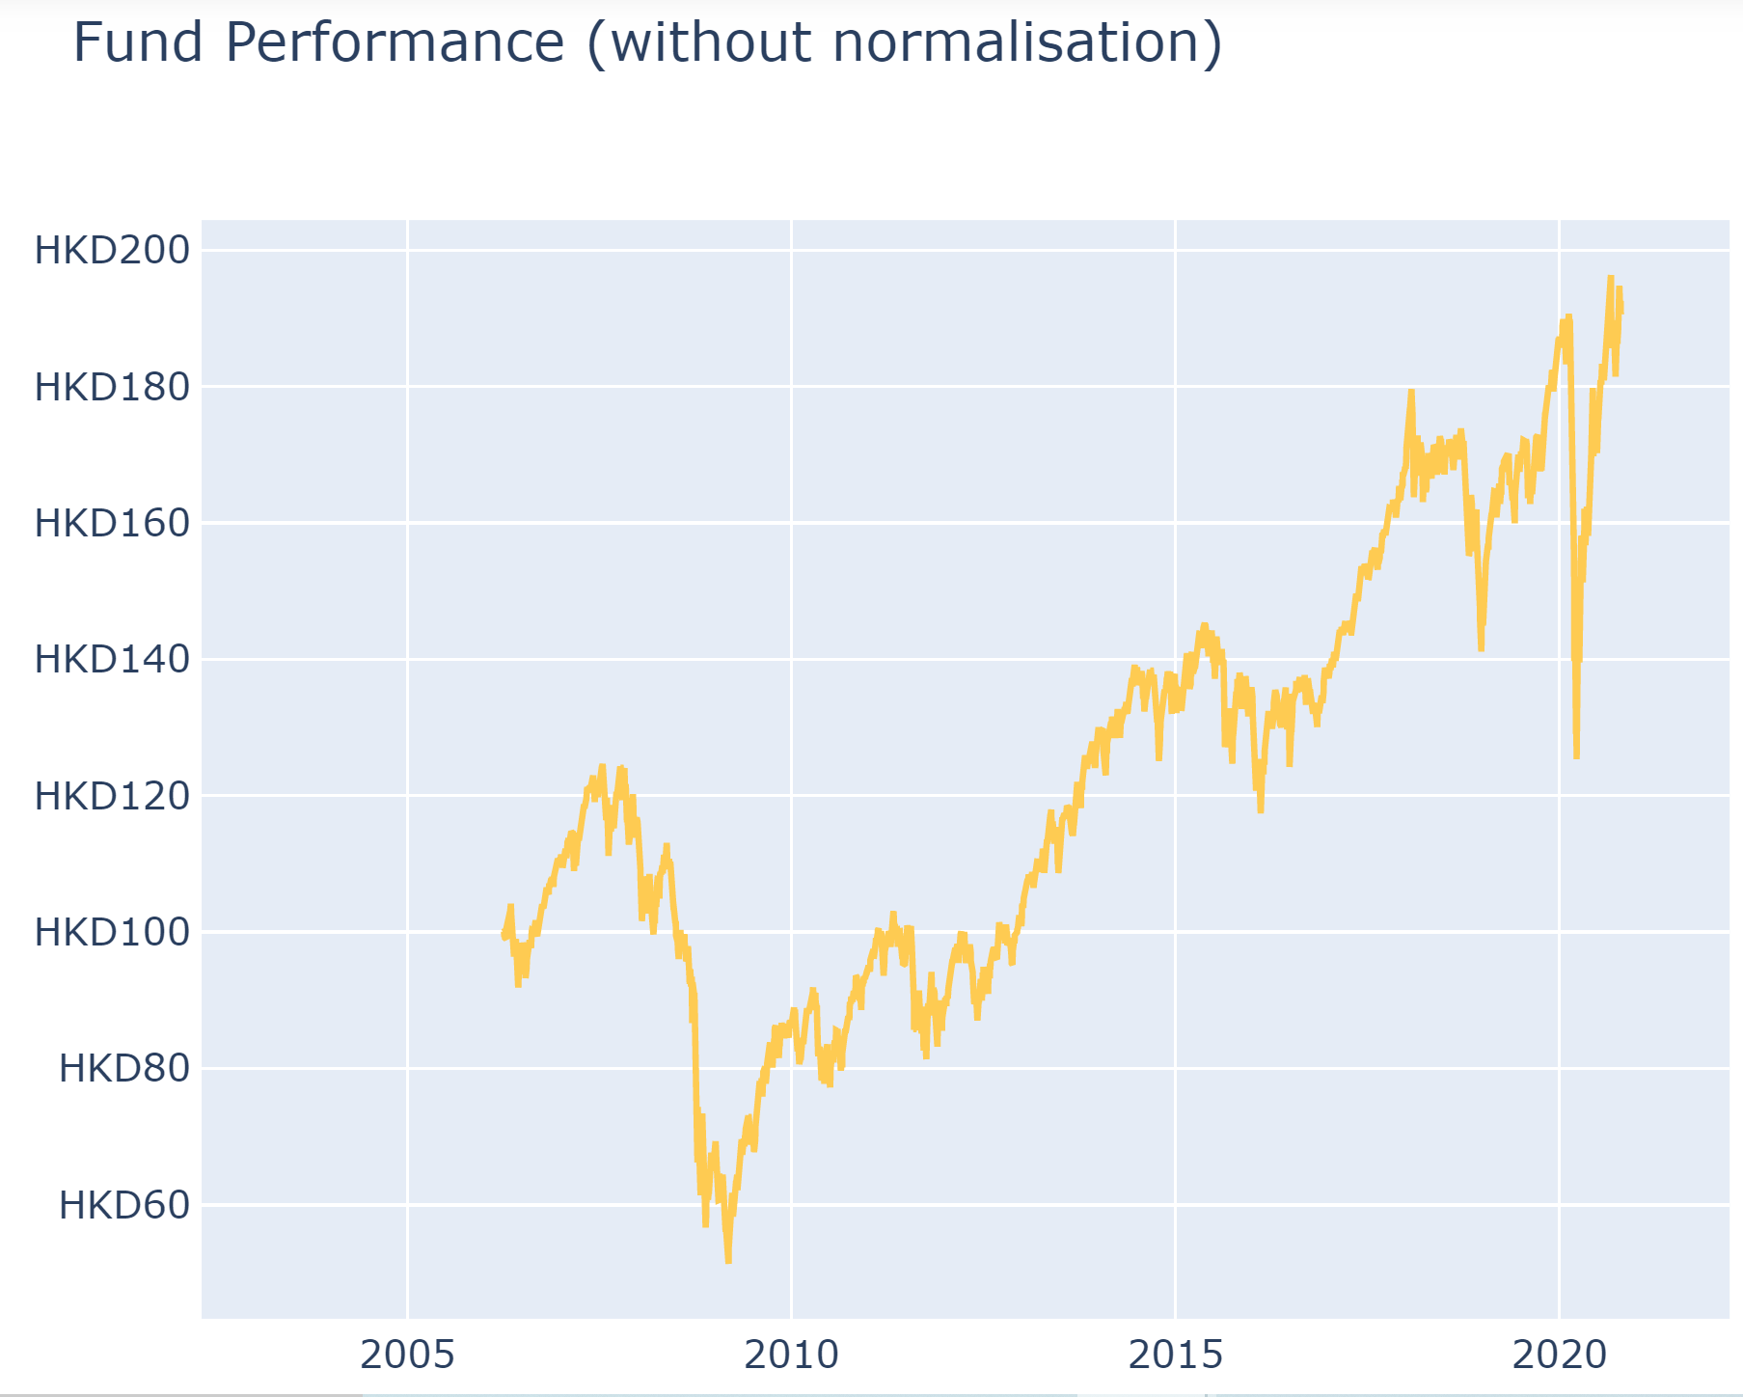
Features Exploration
綠色退休基金

Slide 26
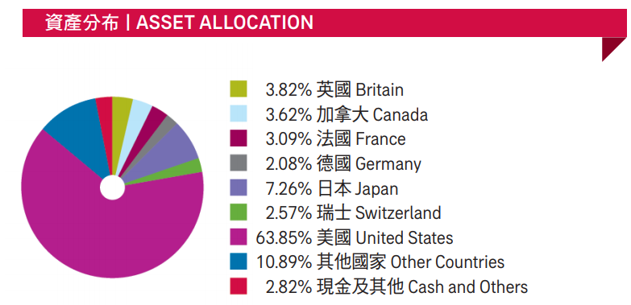
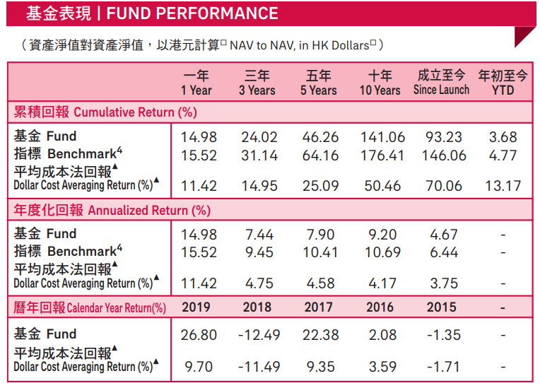
Features Exploration
綠色退休基金
s
source:
aia mpf prime value choice fund performance review-aug-2020

Slide 27

Thank You
&
Q&A

